Slide 1



THE
RHODES SCHOLARSHIP
Information for Academic Advisors

Slide 2




What is the Rhodes Scholarship?
Why encourage your students to apply?
How can you help students to apply?

Slide 3
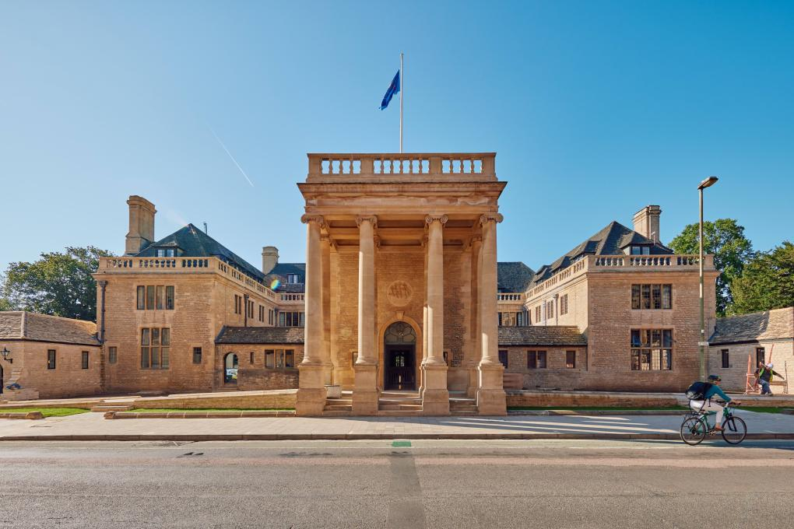

What is the Rhodes Scholarship?

Slide 4


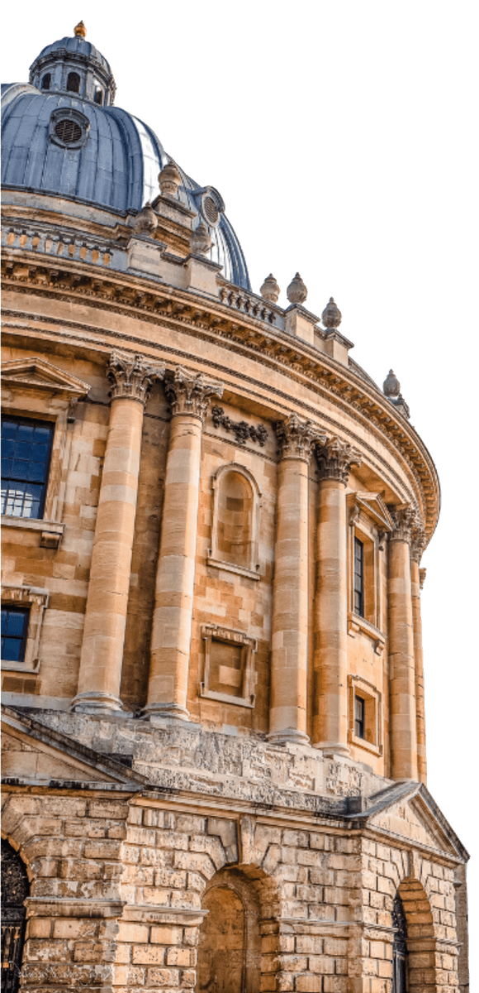
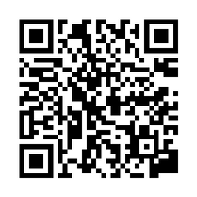
What is the Rhodes Scholarship?
  Established in 1902, the Rhodes Scholarship is the oldest and perhaps most prestigious international scholarship programme in the world.
  It is a merit-based, fully-funded postgraduate award which enables talented young people from around the world to study full-time at the University of Oxford.
  Rhodes Scholars come to the UK for two or more years and can apply to study most full-time postgraduate courses in almost any field offered by the University of Oxford.
Find out more about current Scholars and Alumni achievements:

Slide 5

What is the Rhodes Scholarship?
Each year, 100+ Rhodes Scholarships are awarded, to students from 25 constituencies (country or group of countries):
Australia
India
Southern Africa
Bermuda
Israel
Syria, Jordan, Lebanon & Palestine (SJLP)
Canada
Jamaica
China
Kenya
United Arab Emirates
Commonwealth Caribbean
Malaysia
United States
East Africa
New Zealand
West Africa
Germany
Pakistan
Zambia
Global
Saudi Arabia
Zimbabwe
Hong Kong
Singapore

Slide 6
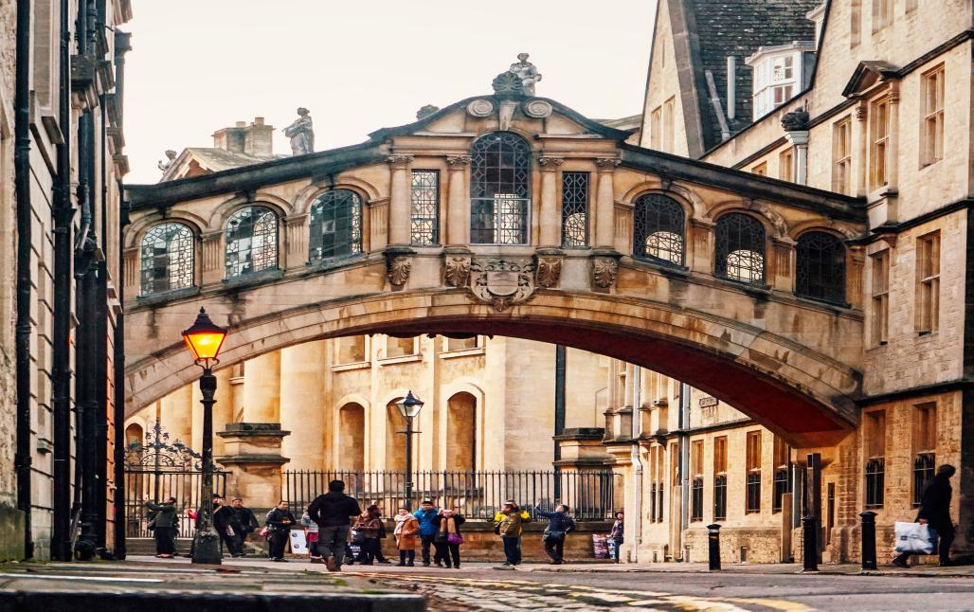
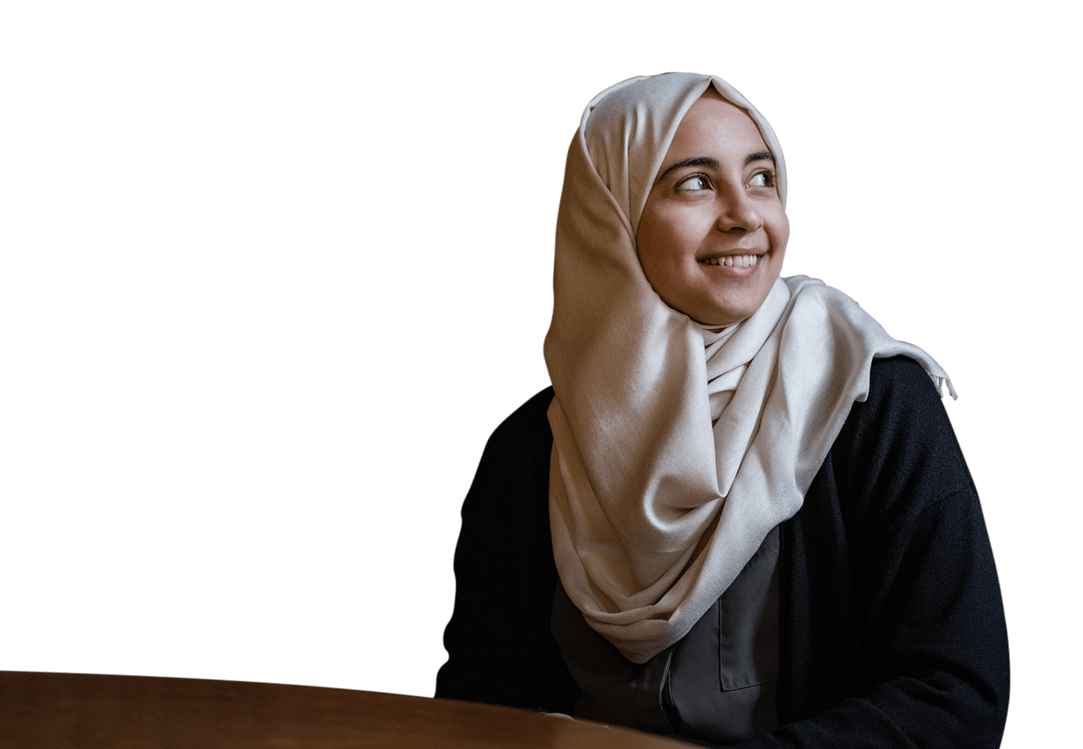
Why encourage students to apply?

Slide 7
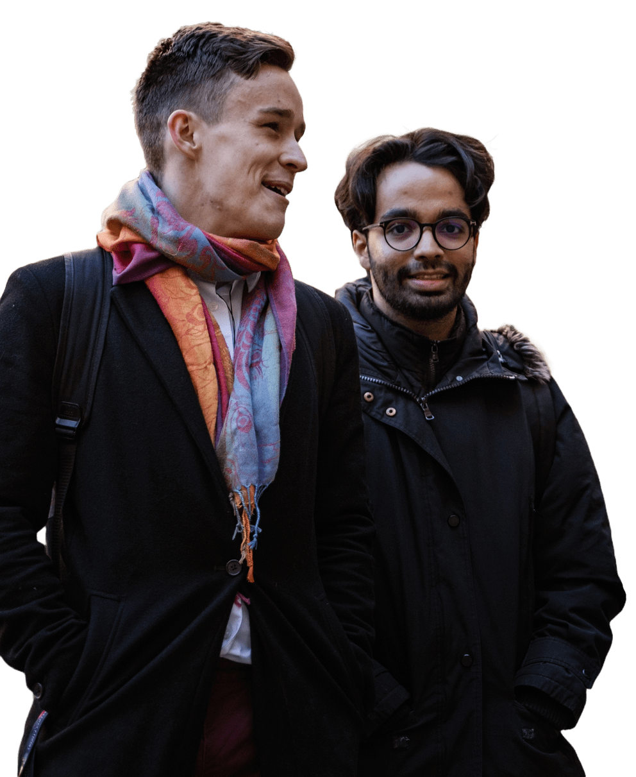
Benefits of Encouraging Applications
Broadening Student's Horizons:
Studying abroad on the Rhodes Scholarship at Oxford University will give your students different perspectives and many opportunities to learn in one of the world’s most cutting-edge academic environments.
Institutional Reputation:
Student and staff populations can take pride in their university/department producing a Rhodes Scholar who will study at Oxford and represent their community.
Outreach:
A winning Rhodes Scholar gains significant media coverage and so will raise awareness of your university. Future students with aspirations for the Rhodes may be more likely to apply to the university.

Slide 8
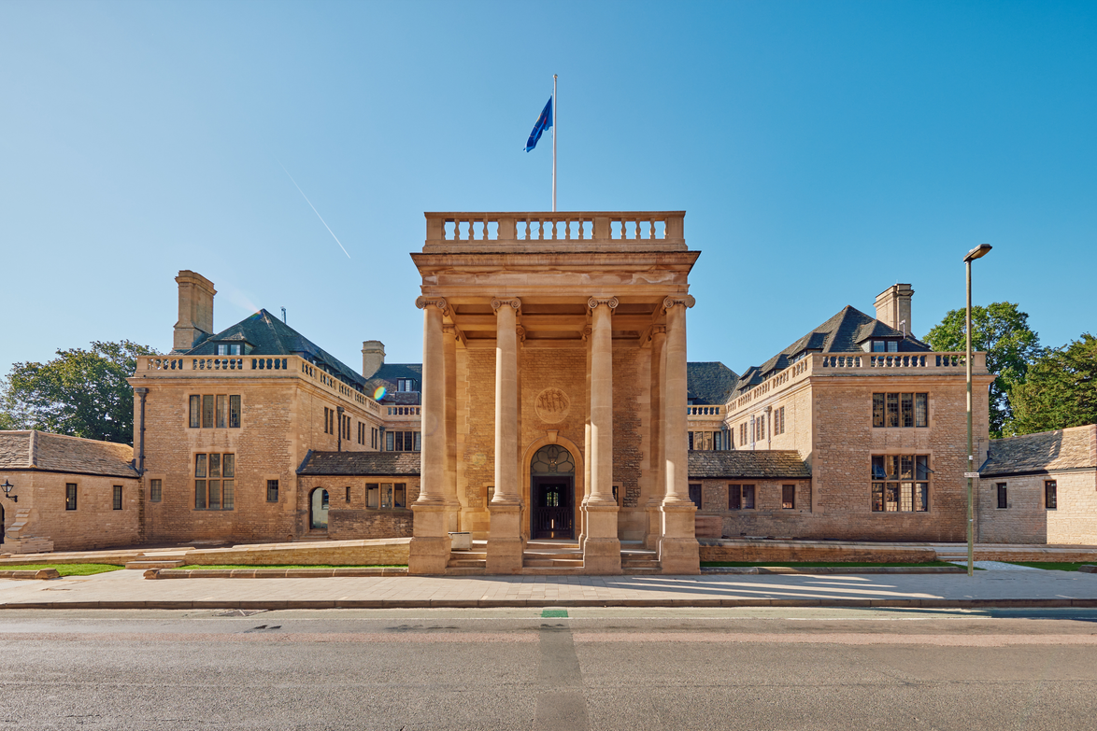
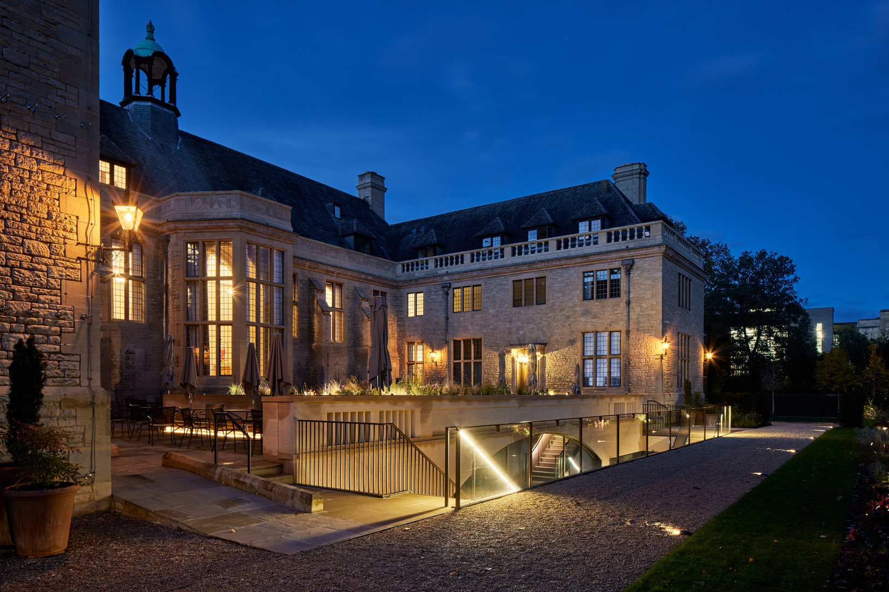
What makes the Scholarship Unique?
In addition to their college and department, they will also have Rhodes House
  This is where the Warden, the Registrar and our dedicated Scholar Team are based. Our staff are present to support Scholars and help ensure their academic, professional and personal success.
  Rhodes House also hosts talks, seminars and forums, and here Scholars will have the opportunity to learn from some of the world’s leading experts and academics from a wide range of disciplines.

Slide 9
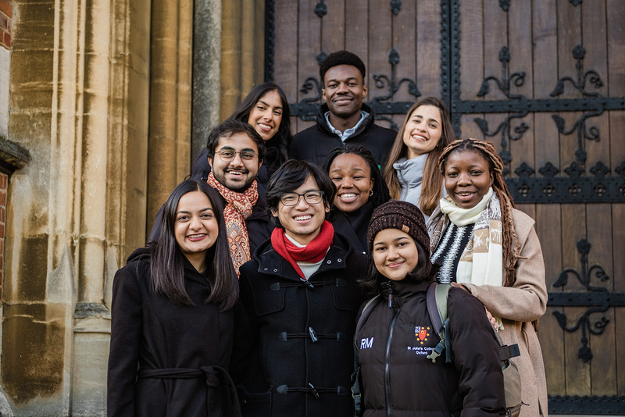
What makes the Scholarship Unique?
Character, Service and Leadership Programme (CSLP)
This is the flagship programme at the core of the Rhodes Scholar experience, providing many different and varied opportunities to learn, connect, and engage across three key areas:
  Understanding themselves and their values
  Building community with others
  Navigating their own path through the world, beginning with their journey at Oxford
Some highlights of the Scholar Programming include:
  Welcome Week
  First and Second Year CSLP Retreats
  Skills workshop sessions
  Speaker series
  Weekly discussions on global challenges

Slide 10



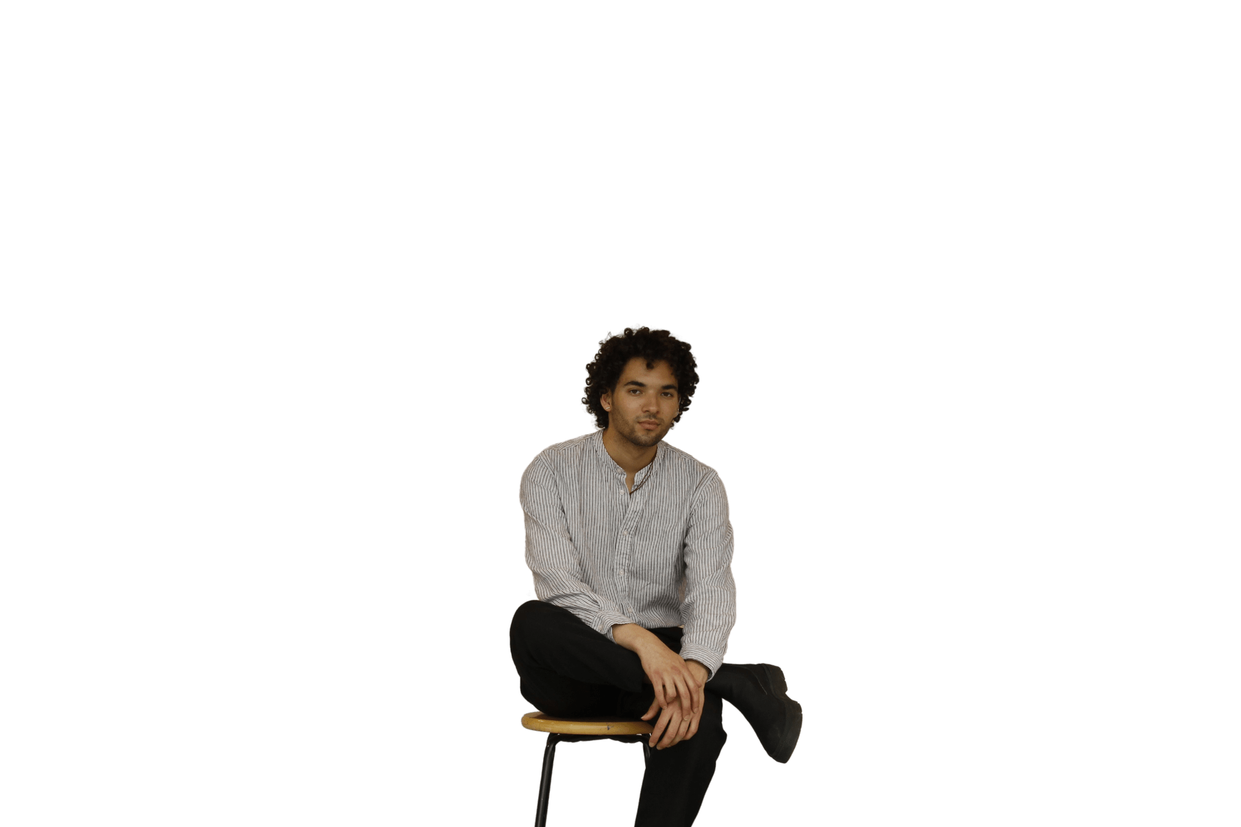

What makes the Scholarship Unique?
The Rhodes Community: A lifelong fellowship
  From the moment Scholars are selected, they will be welcomed into a global, lifelong community of Rhodes Scholars, Alumni, and Fellows from our partnership programmes.
  Beyond gaining access to a powerful professional network, they will connect with thoughtful, kind and ambitious individuals from around the world, collectively striving to drive progress.
“One of the things
I was most excited about
is that idea of the Rhodes
community and the fellowship
that exists beyond this degree that
I’ll have with me for life. It’s access to some of the greatest minds in the world, the leading researchers in different fields. And as an artist, it’s amazing to have that kind
of network set up
for you.”
Joel Nichols Canada

Slide 11


How can you help students to apply?

Slide 12

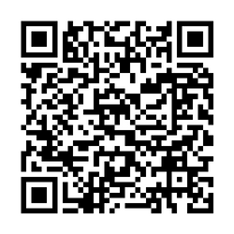
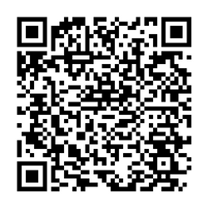
Are they eligible?
Each applicant must fulfil the citizenship and residency requirements of the Rhodes constituency for which they are applying.
Age limits vary between constituencies, ranging between 18 to 24 years and up to a maximum of 27 years in exceptional circumstances.
They must have completed an undergraduate degree (usually a Bachelor’s) by July 2026, and you must have an academic background and grade that – at a minimum — meets or exceeds the specific entry requirements of your chosen course at the University of Oxford.
Eligibility checker
Candidates will have a higher chance of successful admission to University of Oxford if they have:
  A first class Honours degree or equivalent, or,
  GPA of 3.7/4.0 or higher
Equivalent international qualifications

Slide 13
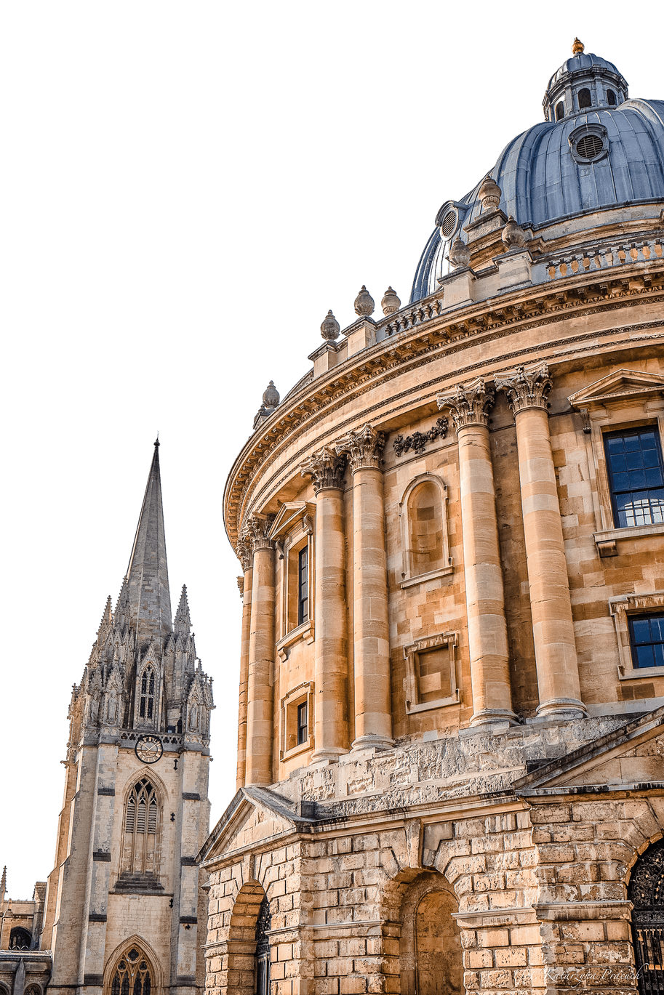
What are the Selection Criteria?
We are looking for young people of outstanding intellect, character, leadership, and commitment to service.
The criteria which were laid out in the Founder’s Will, and have remained largely unchanged since 1902, still guide us today:
  Literary and scholastic attainments (academic excellence);
  Energy to use one's talents to the full (as demonstrated by mastery in areas such as sports, music, debate, dance, theatre, and artistic pursuits, particularly where teamwork is involved);
  Truth, courage, devotion to duty, sympathy for and protection of the weak, kindliness, unselfishness and fellowship;
  Moral force of character and instincts to lead, and to take an interest in one's fellow beings.

Slide 14





The Application Process
Applications Opening and Closing
Rhodes Interview and Selection
Oxford Application
Arrival in Oxford
June to Aug/Sep/Oct 2025*
October to December 2025
December 2025 to March 2026
September 2026
*Note: exact dates vary between constituencies

Slide 15










What do they need?
Birth Certificate
Passport
Transcript
Evidence of Residence
Personal Statement
CV/Resume
Evidence of
English Language Proficiency
Head and Shoulders Photo
Reference Letters
Academic Statement

Slide 16
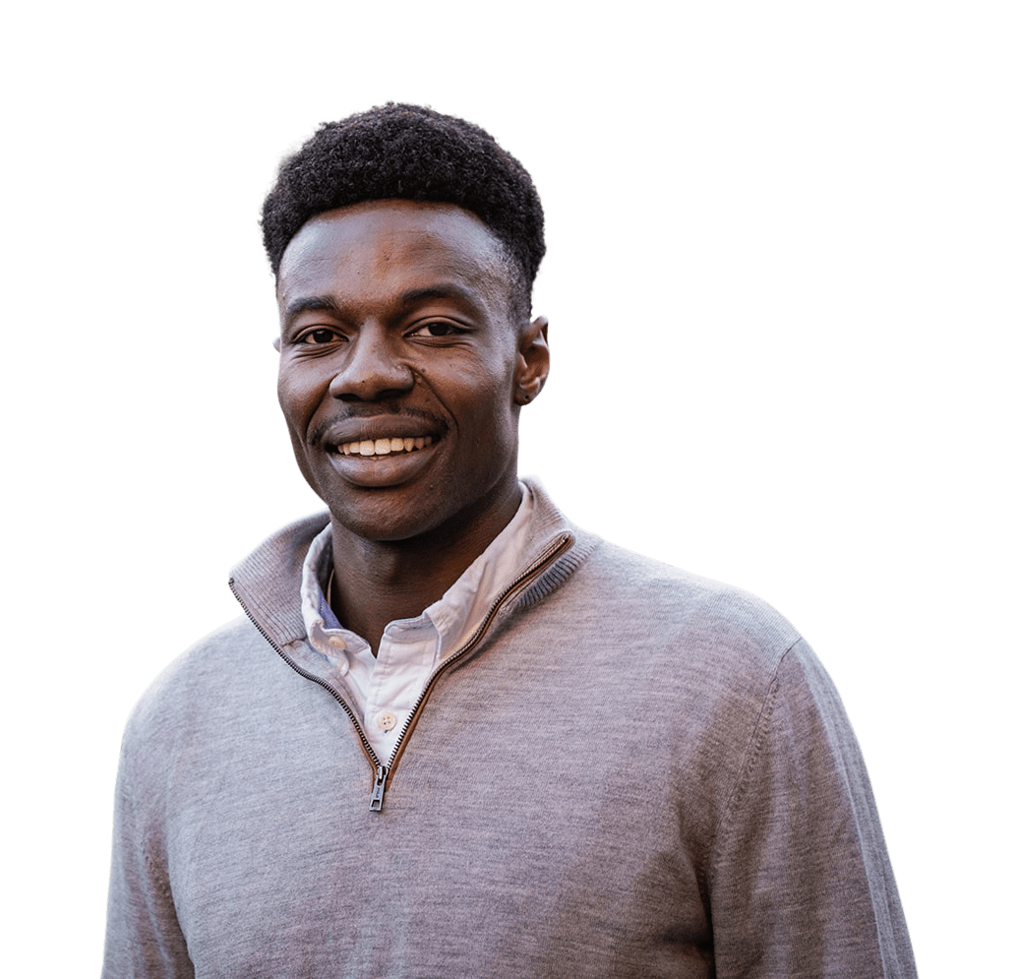
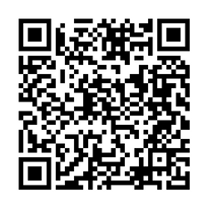
The reference letters - How can you help?
References form a crucial part of the selection process, and therefore a reference could make the difference to an applicant’s success.
  Make sure you understand what’s required from you, read the guidance for referees
  You can ask the applicant their CV, transcript, papers they have written in class etc.
  Can you speak to both their strengths and weaknesses?
  What experiences they had can you speak to that would draw out the best of their qualities and values?
Download the Guidance for referees:

Slide 17
ASK:
EXPLAIN:
PREPARE:
Is the Rhodes Scholarship right for you?
How the application process works
Interview Preparation
  Are they eligible?
  What do they want to achieve with the Rhodes?
  Do they meet the Rhodes selection criteria?
  Would other scholarship opportunities be better suited?
  Help them think about which referees would be best
  Recommend that they check the Rhodes Trust website, and review the 'resources' section
  Have they started to think about their personal statement?
  Have they done a professional interview before?
  Recommend practicing interview skills, and that they ask for help with mock interviews

Slide 18


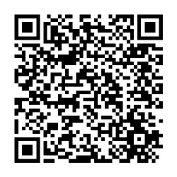
Keep in touch!
Connect with us on Social Media
Get in touch with us by emailing:
outreach@rhodeshouse.ox.ac.uk
Additional resources
Access shareable outreach resources (presentations and flyers) and more information on our website

