Slide 1



THE
RHODES SCHOLARSHIP

Slide 2






What is the Rhodes Scholarship?
What makes it unique?
Could you be a Rhodes Scholar?
How to Apply?

Slide 3

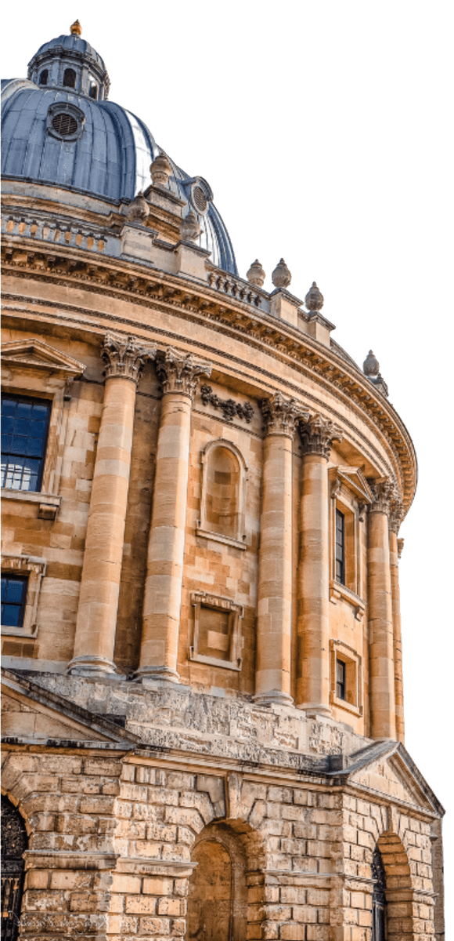
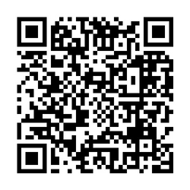
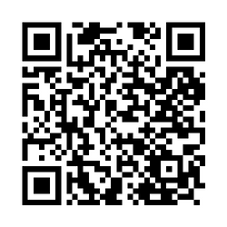
What is the Rhodes Scholarship?
  Established in 1902, the Rhodes Scholarship is the oldest and perhaps most prestigious international scholarship programme in the world.
  It is a fully-funded postgraduate award which enables talented young people from around the world to study full-time at the University of Oxford.
  Rhodes Scholars come to the UK for two or more years and can apply to study most full-time postgraduate courses in almost any field offered by the University of Oxford.
University of Oxford postgraduate courses
Courses covered by the Rhodes Scholarship

Slide 4

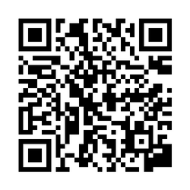
What is the Rhodes Scholarship?
  The Rhodes Scholarship is merit-based, with the purpose of developing public-spirited leaders, and to promote international understanding and peace through an international community of Scholars.
  There is no such thing as a 'type' when considering who gets selected.
  Today’s Rhodes Scholars include medical researchers, social workers, Presidents, Prime Ministers, artists, journalists, lawyers, teachers, activists, poets, doctors and many more!
Find out more about current Scholars and Alumni achievements:

Slide 5


What does the Rhodes Scholarship cover?
  Following selection for the Scholarship, the Rhodes Trust will cover the fee required to apply to study at the University of Oxford, as well as your course (and college) fees.
  The Rhodes Scholarship also provides an annual stipend to cover living costs, including accommodation and food.
  The Trust will cover the fee for a Tier 4 study visa and the associated International Health Surcharge (IHS).
  We cover two economy class flights - to and from the UK - for the beginning and end of studies in Oxford. On arrival in Oxford, Scholars also receive a settling in allowance.

Slide 6
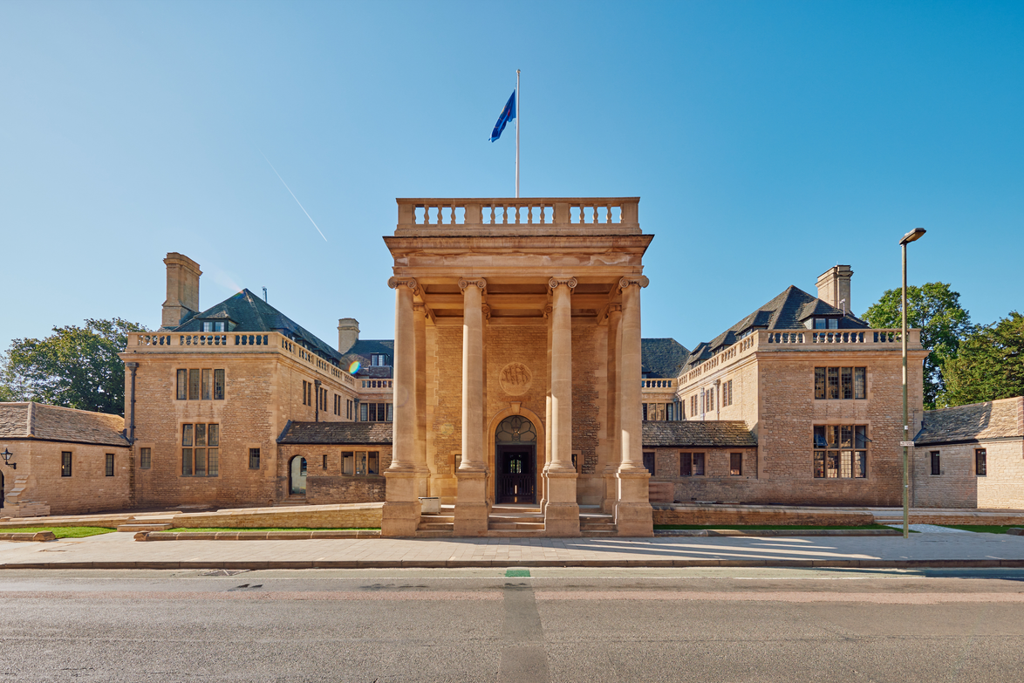
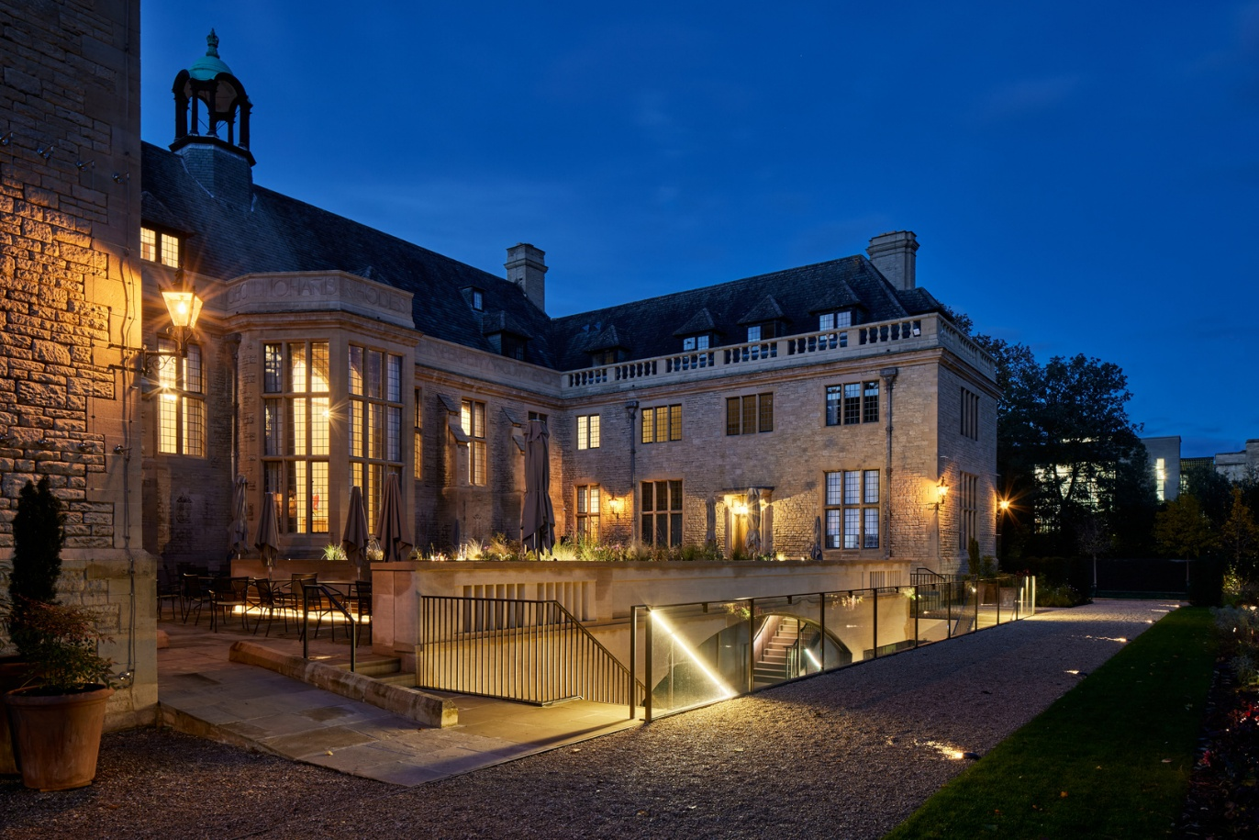
What makes the Scholarship Unique?
In addition to your college and department, you will also have Rhodes House
  This is where the Warden, the Registrar and our dedicated Scholar Team are based. They are present to support you and help ensure your academic, professional and personal success.
  It has study spaces, a library, a café and communal spaces where you will meet other Scholars.
  Rhodes House hosts talks, seminars and forums with world-leading experts, academics and guests.
  Scholars also attend social events such as the Coming Up Dinner and the Rhodes Ball.

Slide 7
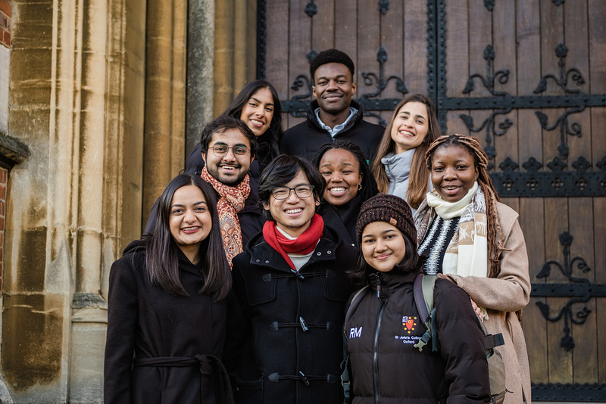
What makes the Scholarship Unique?
Character, Service and Leadership Programme (CSLP)
This is the flagship programme at the core of the Rhodes Scholar experience, providing many different and varied opportunities to learn, connect, and engage across three key areas:
  Understanding yourself and your values
  Building community with others
  Navigating your own path through the world, beginning with your journey at Oxford
Some highlights of the Scholar Programming include:
  Welcome Week
  First and Second Year CSLP Retreats
  Skills workshop sessions
  Speaker series
  Weekly discussions on global challenges
  And more!

Slide 8



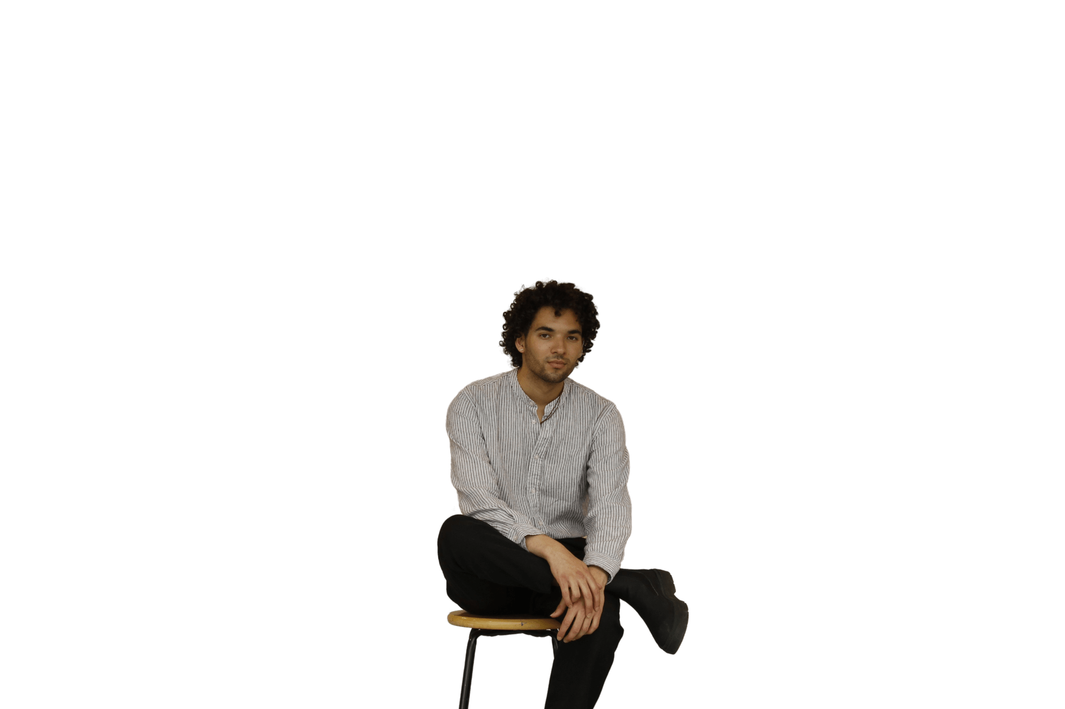

What makes the Scholarship Unique?
The Rhodes Community: A lifelong fellowship
  From the moment you are selected, you will be welcomed into a global, lifelong community of Rhodes Scholars, Alumni, and Fellows from our partnership programmes.
  Beyond gaining access to a powerful professional network, you will connect with thoughtful, kind and ambitious individuals from around the world, collectively striving to drive progress.
“One of the things
I was most excited about
is that idea of the Rhodes
community and the fellowship
that exists beyond this degree that
I’ll have with me for life. It’s access to some of the greatest minds in the world, the leading researchers in different fields. And as an artist, it’s amazing to have that kind
of network set up
for you.”
Joel Nichols Canada

Slide 9
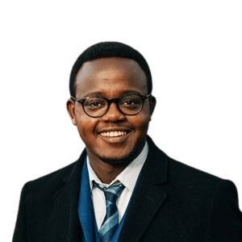
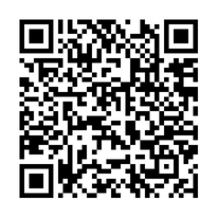

What makes the Scholarship Unique?
You will study at the University of Oxford
  The University of Oxford consistently ranks among the top universities globally.
  You will have access to world-leading academic departments covering a wide range of disciplines.
  You will be part of an interdisciplinary college community with outstanding social, sports and cultural facilities.
“Words cannot do justice
to the experience of being a
student at this great university,
reading from the historic Bodleian libraries, and working alongside some
of the brightest minds in the world. If you are reading this, and considering to be the next Rhodes Scholar, I wish to tell you that you are more than qualified, that you should stop second guessing
yourself, and put forward
a strong application.”
More reasons to choose Oxford for your postgraduate studies:
Daniel Mwendwa
Kenya

Slide 10

Are you eligible?
Each year, 100+ Rhodes Scholarships are awarded to students
from 25 constituencies (country or group of countries):
Australia
India
Southern Africa
Bermuda
Israel
Syria, Jordan, Lebanon & Palestine (SJLP)
Canada
Jamaica
China
Kenya
United Arab Emirates
Commonwealth Caribbean
Malaysia
United States
East Africa
New Zealand
West Africa
Germany
Pakistan
Zambia
Global
Saudi Arabia
Zimbabwe
Hong Kong
Singapore

Slide 11

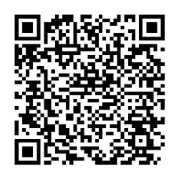
Are you eligible?
Each applicant must fulfil the citizenship and residency requirements of the Rhodes constituency for which they are applying.
Age limits vary between constituencies, ranging between 18 to 24 years and up to a maximum of 27 years in exceptional circumstances.
You must have completed an undergraduate degree (usually a Bachelor’s) by July 2026, and you must have an academic background and grade that – at a minimum — meets or exceeds the specific entry requirements of your chosen course at the University of Oxford.
University of Oxford postgraduate courses
Candidates will have a higher chance of successful admission to University of Oxford if they have:
  A first class Honours degree or equivalent, or,
  GPA of 3.7/4.0 or higher
Equivalent international qualifications

Slide 12




Could you be a Rhodes Scholar?
Rhodes Scholars come from all backgrounds, and we welcome applications from talented young people everywhere.
Energy to use one's talents to the full
Academic achievement and excellence
(as demonstrated by mastery in areas such as sports, music, debate, dance, theatre, and artistic pursuits, particularly where teamwork is involved)
What do we look for in a candidate?
The courage and skills required to lead with a wider desire for public good.
Truth, courage, devotion to duty, sympathy for and protection of the weak, kindliness, unselfishness and fellowship.

Slide 13










What do you need?
Birth Certificate
Passport
Transcript
Evidence of Residence
Personal Statement
CV/Resume
Evidence of
English Language Proficiency
Head and Shoulders Photo
Reference Letters
Academic Statement

Slide 14





The Application Process
Applications Opening and Closing
Rhodes Interview and Selection
Oxford Application
Arrive in Oxford!
June to Aug/Sep/Oct 2025*
October to December 2025
December 2025 to March 2026
September 2026
*Note: exact dates vary between constituencies

Slide 15

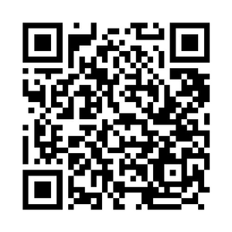

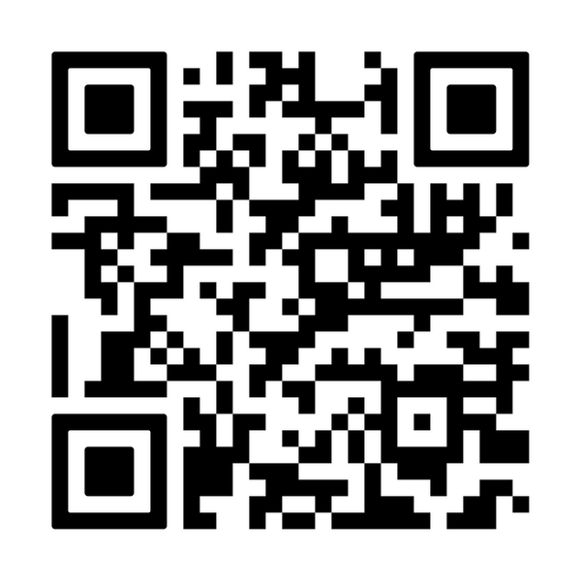
Check your eligibility and apply!
Find out more about the Scholarship and apply by visiting our website:
www.rhodeshouse.ox.ac.uk/apply
Follow us on social media!
Our social media channels are a great place to learn more about the Scholarship.
Join our broadcast channel on Instagram
To keep track of key application dates, access useful resources, and learn more about the experiences of current Rhodes Scholars.

Slide 16
Good luck!

